Slide 1

Analyzing Amazon Sales Data Analysis
- JYOTI BHOSALE

Slide 2
Introduction
The world of e-commerce is highly competitive, and Amazon sellers and sellers are constantly challenged to understand and leverage their sales data. Amazon sales data analysis is critical for businesses to gain valuable insights and make informed decisions.
This article explains the importance of data analytics and how to access and use your data to improve your business performance.
Sales management has gained importance to meet increasing competition and the need for improved methods of distribution to reduce costs and increase profits.
Sales management today is the most important function in a commercial and business enterprise.

Slide 3
business Management
Help out to make better business decisions.
Help analyze customer trends and satisfaction, which can lead to new and better products and services.
Gives better insight into the customer base.
Helps in easy flow for managing resources.
Identifying consumer preferences and trends is important for improving marketing campaigns.
Developing reports by extracting transforming-loading data that contains sales trends related to year, month, and quarter and finding some relationship through the data to understand and analyze the facts.

Slide 4





data collection
Data Identification
Total Cost
Unit Sold
Data Analysis
Total Profit
Data visualization
Dataset
Total Revenue
Unit Price

Slide 5
Quick Insight
93.18M
Total Cost
44.17M
Total Profit
137.35M
Total Revenue
512.87k
Total units Sold
100
Total Items Types

Slide 6
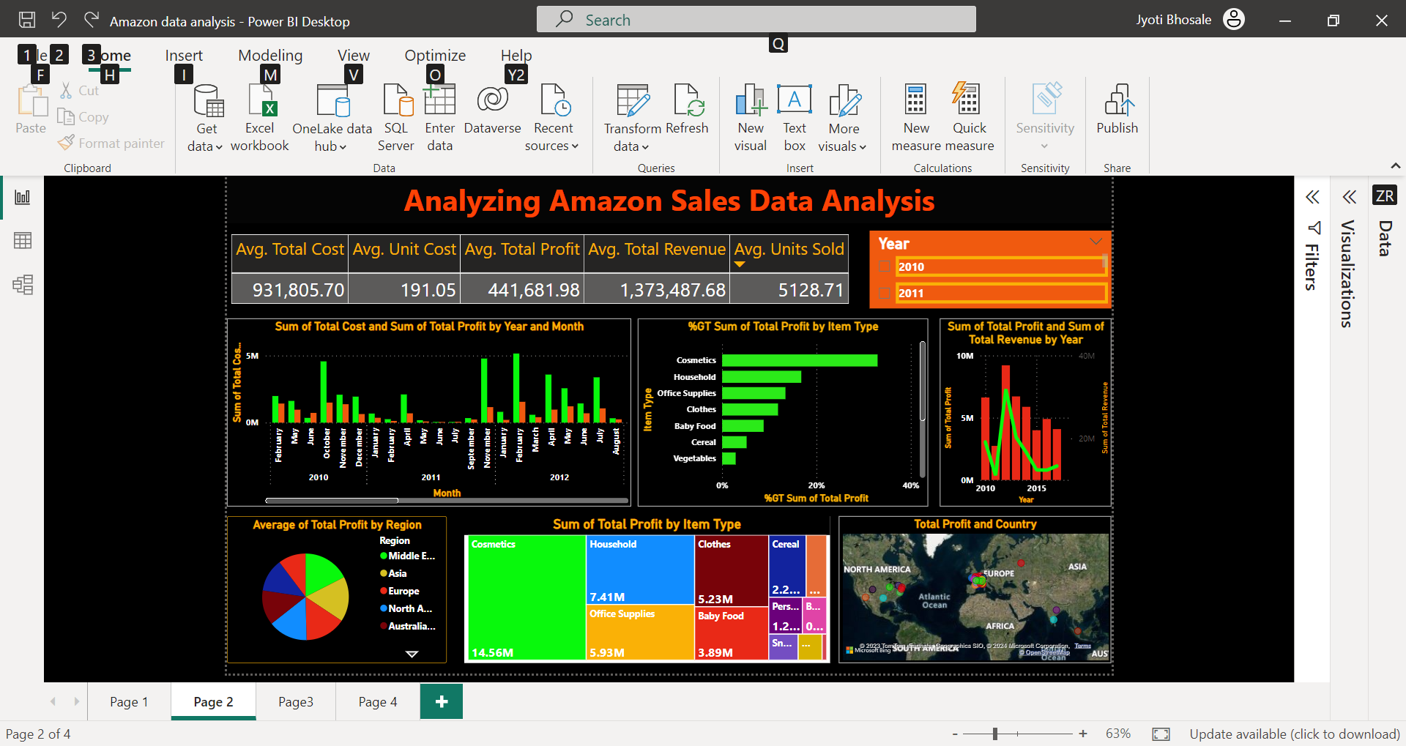
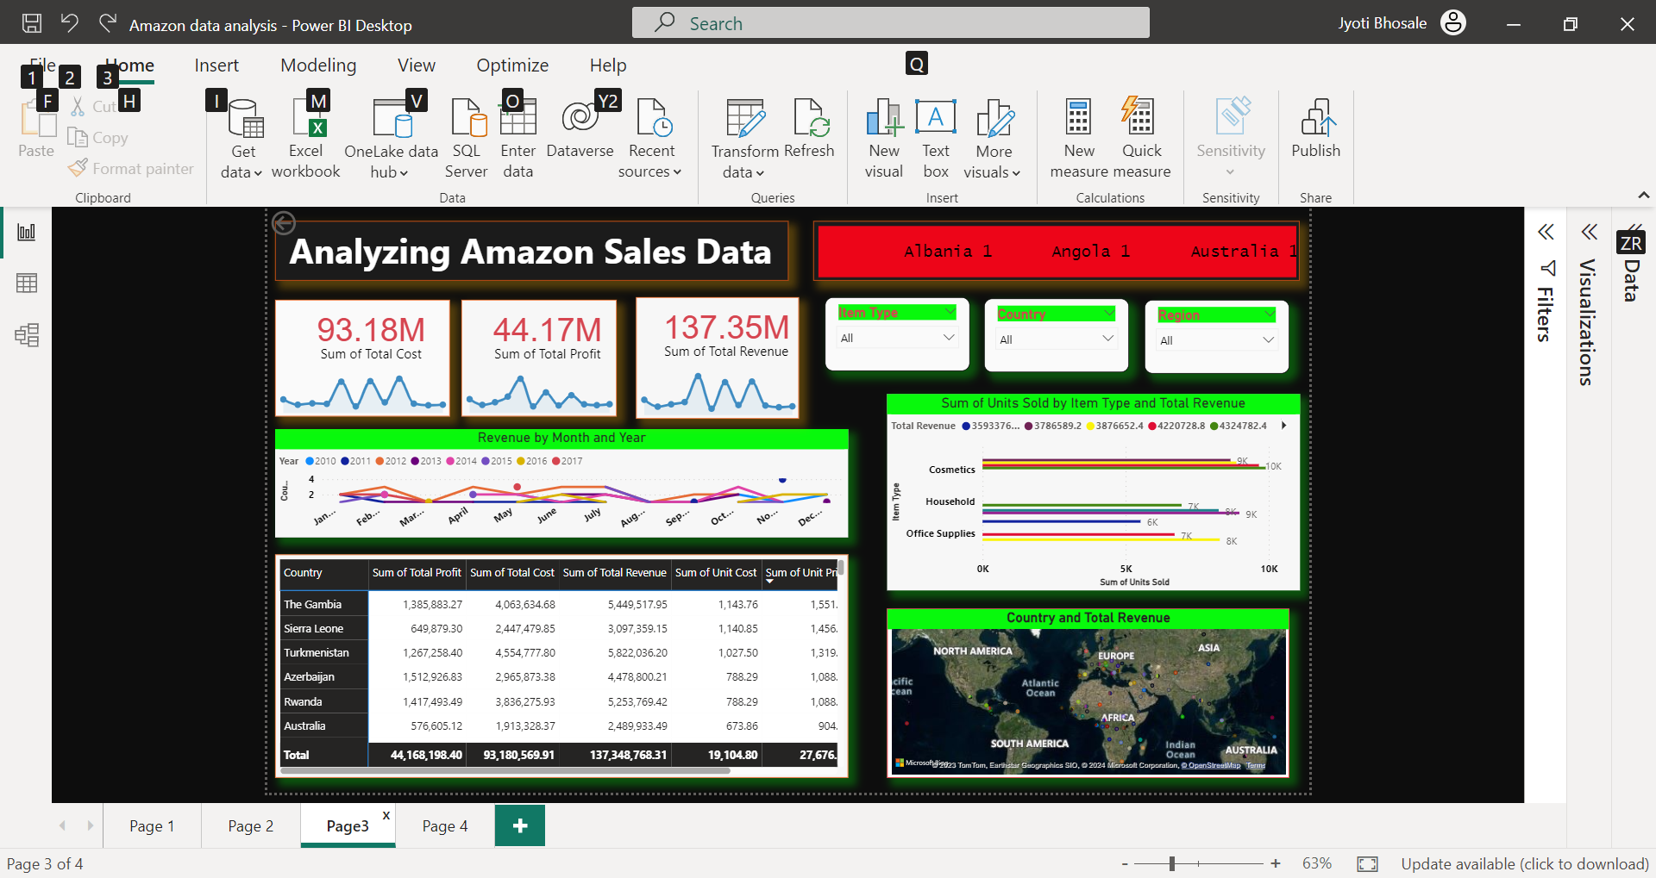
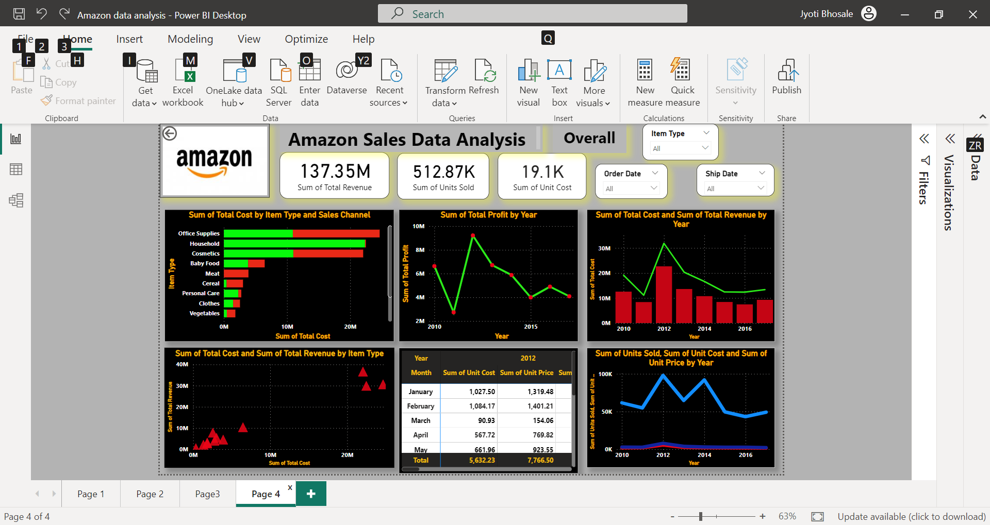
Analyzing Amazon Sales Data Analysis dashboards

Slide 7
Top Revenue by country

Slide 8
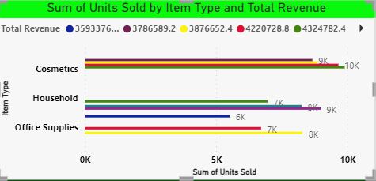
Top 10 Customers w.r.t revenue

Slide 9
Thank you

